Slide 1



Intro to Programming with python
Uzair JAWAID
SUMMER 2020

Slide 2



Who am i?
Uzair Jawaid
Brampton, ON
McMaster University
Computer Engineering
Software Developer

Slide 3
Lecture 1
What is programming, how did it start, and why is it useful in the 21st Century
Intro to Python
What is an IDE?
First ‘Hello World’ script
What can we build?

Slide 4

What is programming?
Set of instructions for the computer
Read at low level and is compiled and written at a high level
Low level: Assembly, Opcodes, Machine Language
Opcode translated to Binary
High Level: C, Java, Python
Translates to machine code every time
First compiler (1950s) - Autocode

Slide 5


Slide 6
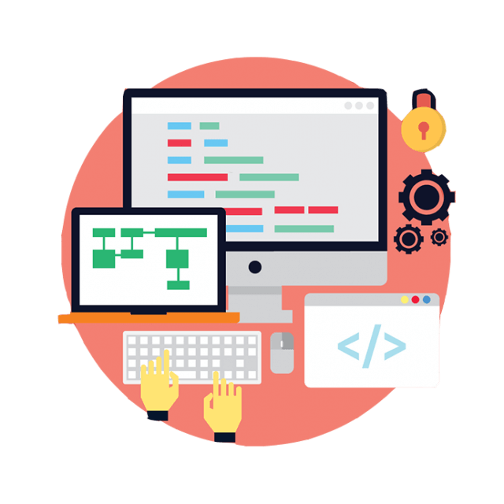
Python
High-level
Object-oriented
Interpreted
No compilation step
Scripting
Web development
Game development
Data Science and more

Slide 7


Compilation vs interpretation
Compilers produce result in Assembly code
Sorting and combining modules and translating into machine code
Not human readable
Only work on the architecture it was designed for
C, Java,
Interpreters produce results from a program
Parsed lines before sending to the machine the instructions
Portable
Slower than compiled languages
Python, JavaScript, Perl

Slide 8
SYNTAX AND SEMANTICS
Syntax – grammar of coding
Semantics – the logic of coding
Syntax could be correct however the semantic of the code may not be
The fox walks the sky at the ocean
“Computers are good at following instructions, but they can’t read your mind”
print()

Slide 9
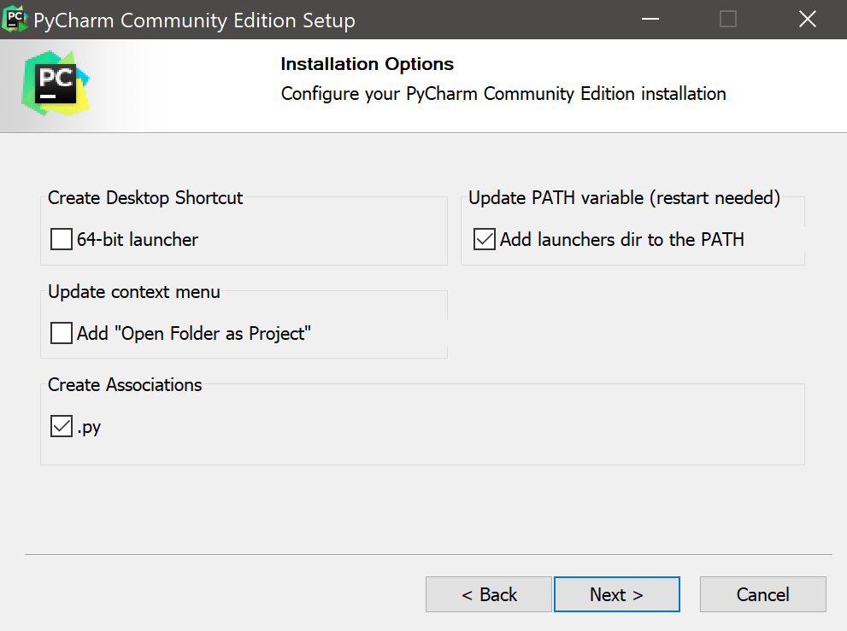
Installing Pycharm
https://www.jetbrains.com/pycharm/download/#section=windows
Community version
Select the two options from the screenshot
Accept terms and conditions
Click Next until completion

Slide 10
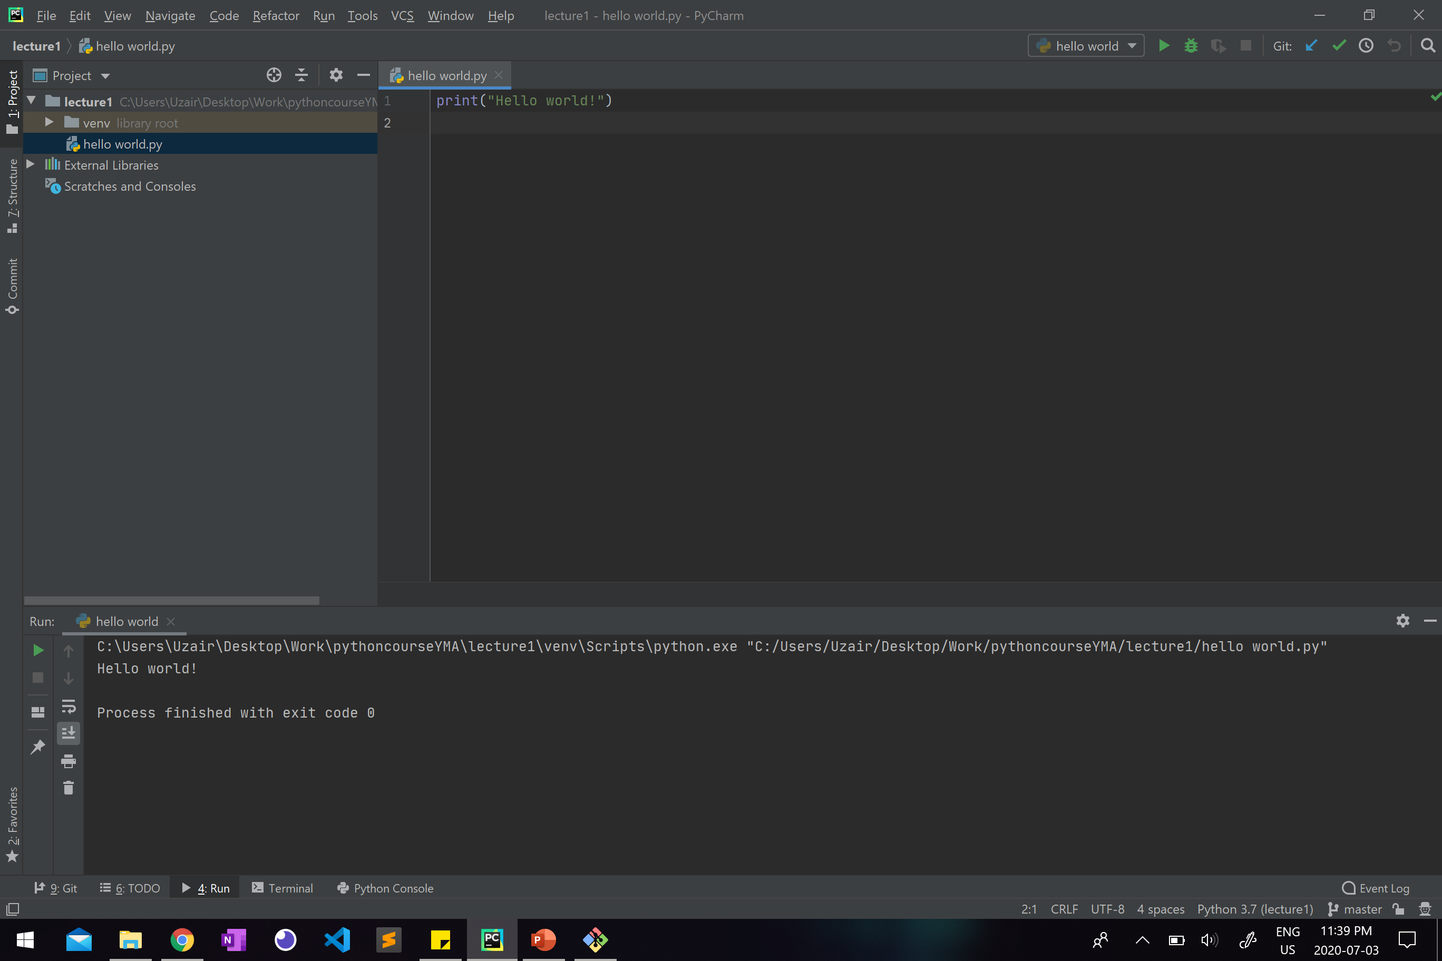
PYTHON IDE - PYCHARM

Slide 11
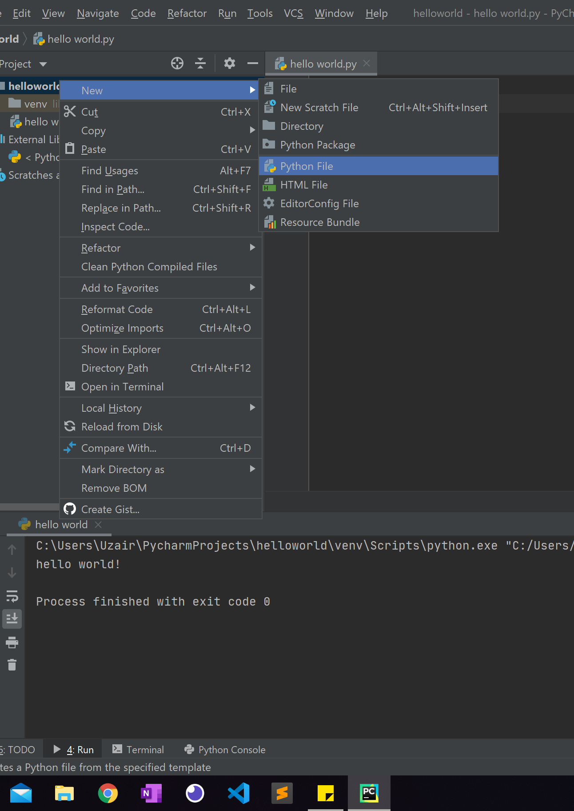
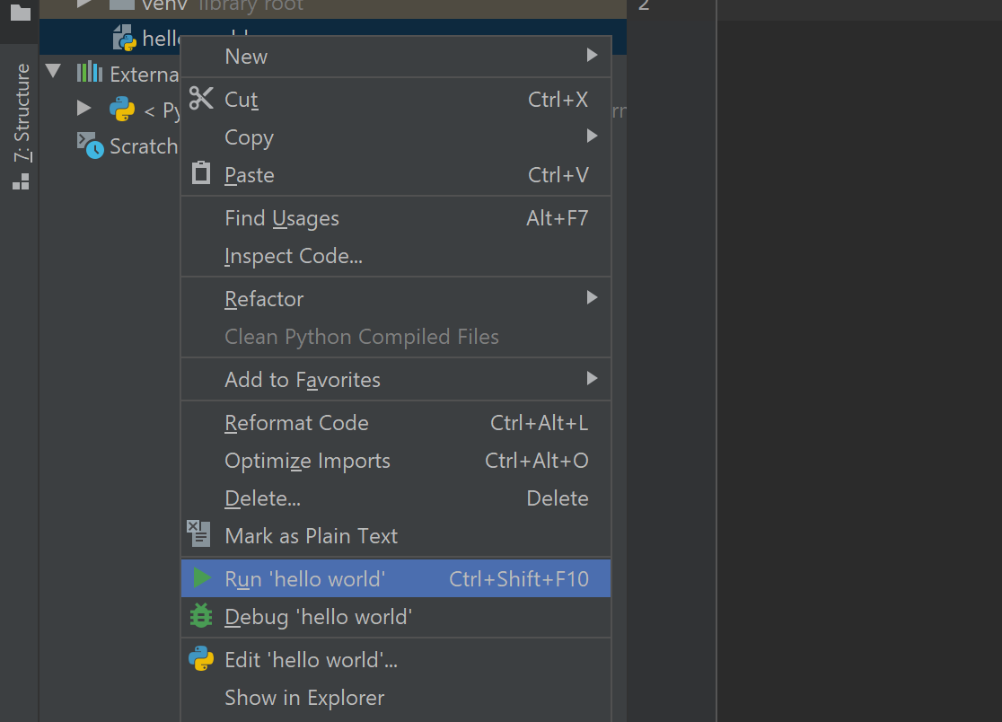
First program
Create new Python file
Code
print(“hello world”)
Right click on file and run
Check terminal for output
Course material can be found at https://github.com/UzairJ99/pythoncourseYMA

Slide 12

Lets code
What happens when we run each of these?
prin(“hello world”)
print(“hello world)
print(hello world)
print()
print(5)
Print(“5”)

Slide 13
Lets code
prin(“hello world”)
print(“hello world)
print(hello world)
print()
print(5)
Print(“5”)
Unresolved reference 'prin’
',' or ')' expected
Create class Hello
5
5

Slide 14
WHERE CAN WE GO WITH THIS NOW?
Data Science
Web Development
Game Design
Mobile App Development
Software Development
Machine Learning

Slide 15
DATA TYPES AND ARITHMETIC
Next Class :

